Slide 1


The Importance of Teamwork for Biomedical Research in a Rapidly Changing World
NJ ACTS Team Science Co-Leads:
Richard Dool, Daniel B. Horton, Nancy E. Reichman

Slide 2

To Team or
Not to Team?
  Increasing need for high functioning teams in biomedical research
  Effective teamwork can enhance the importance and impact of research
  Effective leadership is critical for team success

Slide 3

Skills and Competencies for
Effective Teams
NJ ACTS Team Science Video Series
High-impact biomedical research increasingly requires inter- and trans-disciplinary teamwork and the ability of leaders to stimulate, support, and encourage team effectiveness.
Successful collaborative research requires competencies (e.g., leadership, communication, conflict management) that extend beyond most biomedical researchers’ traditional disciplinary training.
This video series will highlight key issues in management science and the business world that can be applied to enhance the effectiveness of biomedical research teams.

Slide 4


A decade of disorientation:
The biggest leadership challenge of the future

Slide 5
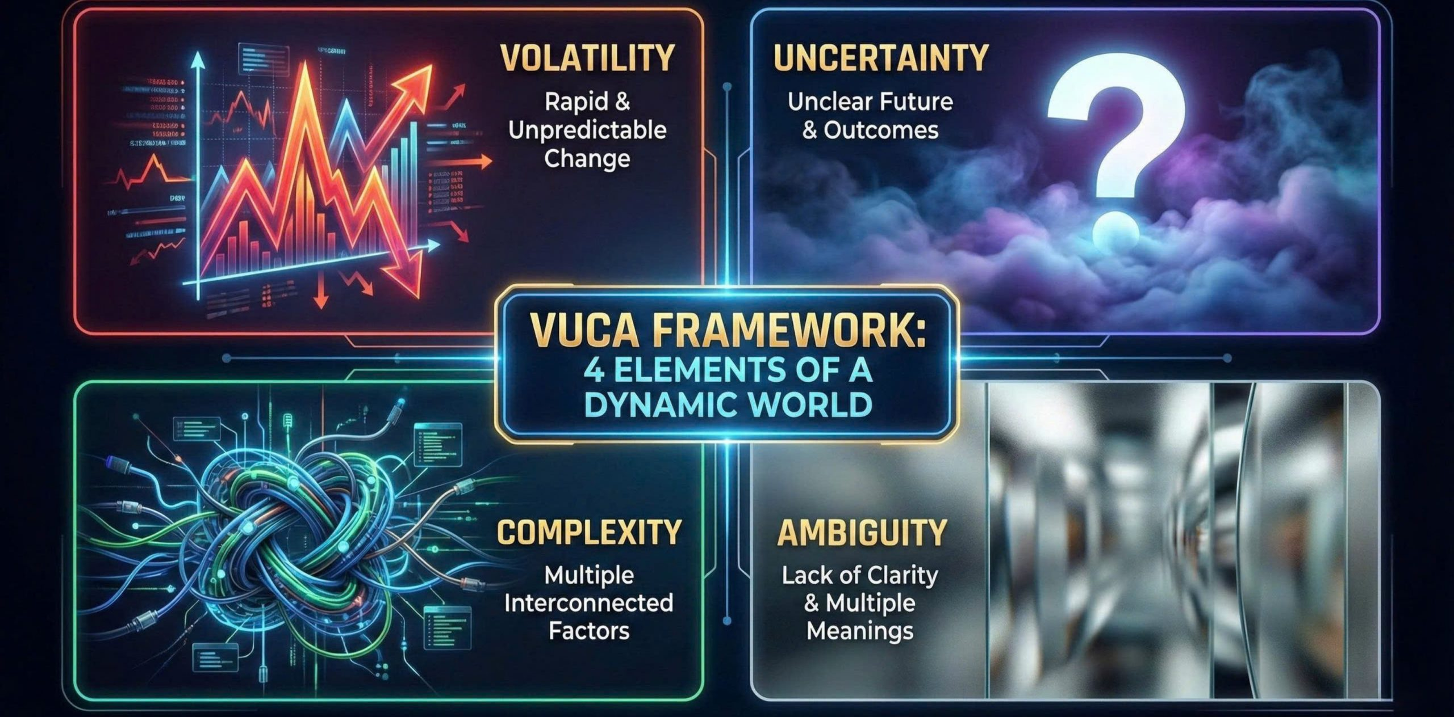


“Uncertainty is an inherent trait of the future.”
Roger Spitz, Disrupt With Impact: Achieve Business Success in an Unpredictable World

Slide 6
Leadership Reality of Now….
Leaders
Systemic impatience

Slide 7


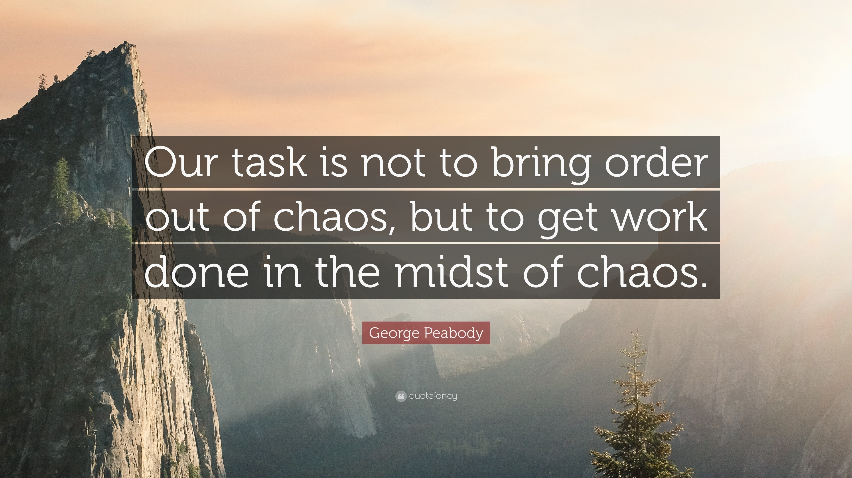
Dynamics of a VUCA World

Slide 8

The Most Important
Leadership Competencies
Center for Creative Leadership (2025)
1. Strategic Perspective
2. Being a Quick Study
3. Decisiveness
4. Change Management
5. Leading Employees
6. Confronting Problem Employees
7. Participative Management
8. Building Collaborative Relationships

Slide 9
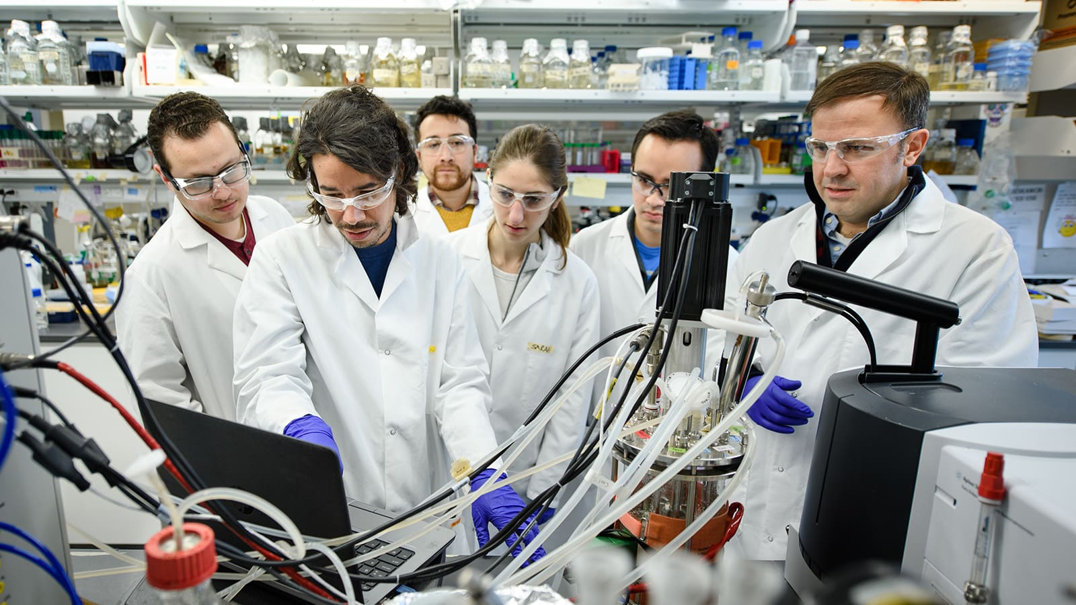
How Are Leaders
and Organizations Coping?
They are deploying TEAMS in many
different forms and sizes.
81% of executives say work is increasingly performed across functional boundaries
(Deloitte, 2024)
90% of employees report being part of a team at work
(ADP, 2025)

Slide 10

Teams Matter…..
McKinsey analyzed data from more than 1,700 teams across 75 organizations and concluded that more effective teams consistently achieve higher levels of productivity, speed, quality, and overall organizational effectiveness.
(Comella-Dorda et al., 2024)

Slide 11

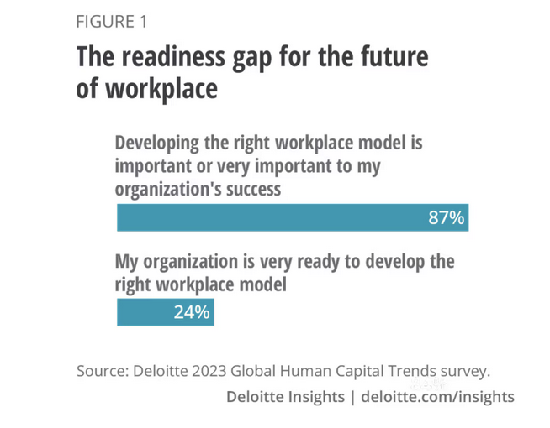
But… Are We Ready?
About 75% of employers rate teamwork and collaboration as “very important,” yet only 18% of employees are formally evaluated on this in annual performance appraisals.

Slide 12

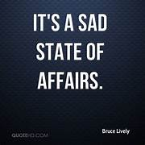
Only 29% of nearly 18,000 employees surveyed reported being satisfied with their collaboration experiences and outcomes at work, down from 36% in 2021 (Gartner, 2024)
1
77% of organizations admitted they are not investing enough time and budget into team development (Assoc. for Talent Development, 2020)
Stark Reality
2
Only 24% of organizations identified developing team leadership capabilities as a top priority to improve leadership effectiveness (Brandon Hall Group, 2024)
34

Slide 13
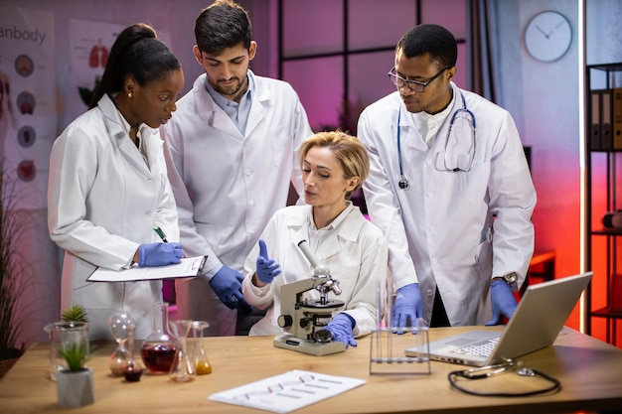
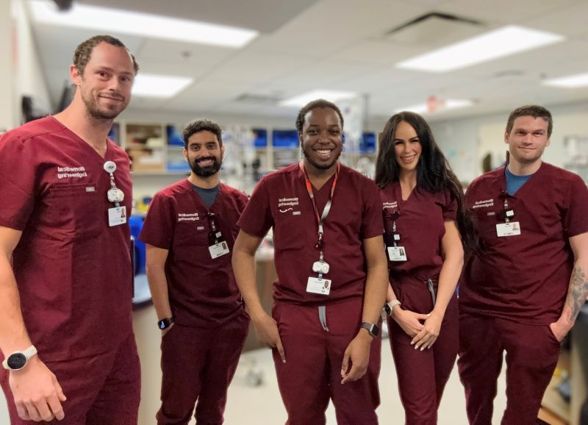
Teams and Performance
High-Performing Teams
United in purpose
Sustained results exceeding expectations
Win together
< 30%
Work Groups
Some shared purpose
Some coordination
Meet some or most expectations
± 50%
Collection of Individuals
Generally do not work or collaborate well
Perform below expectations
< 20%

Slide 14
The “Math” of High-Performing Teams (HPTs)
When a team is going well……
The whole is greater than the sum of the parts….
2 + 2 = 5

Slide 15
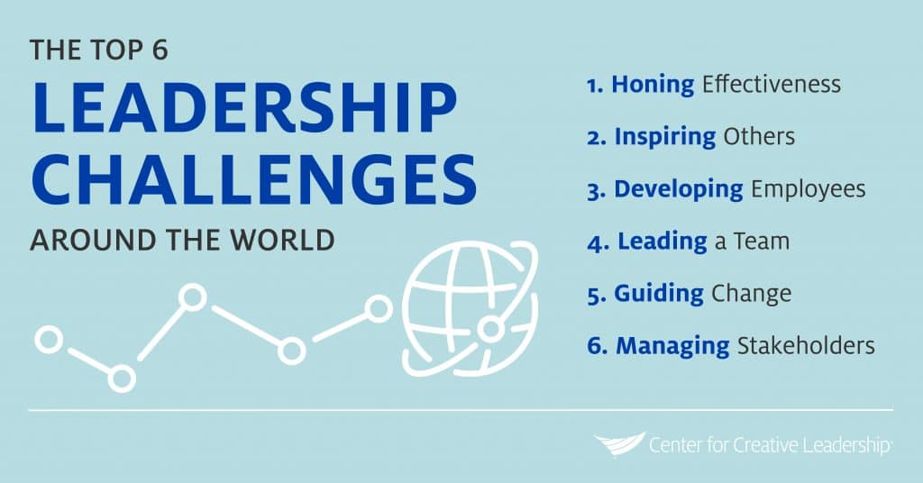

Slide 16

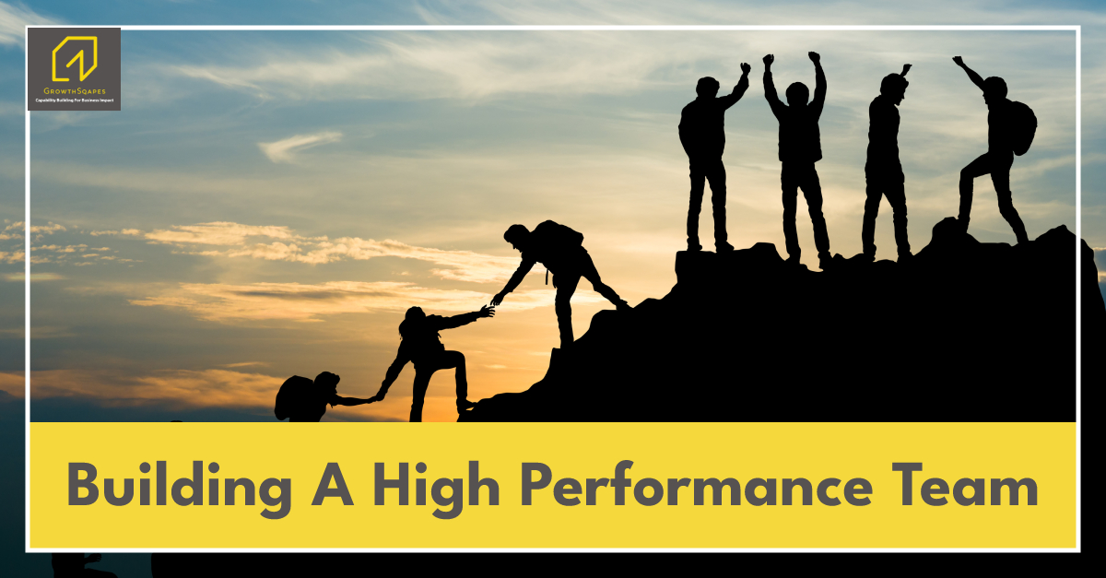
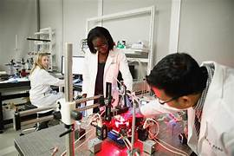

Our Goals
  To help leverage or enhance your teaming skills
  To help you be a more effective team member and leader
  To help more biomedical research teams reach high-performing status

Slide 17

Team Effectiveness
This video series will highlight key issues in management science and the business world that can be applied to enhance the effectiveness of biomedical research teams.

Slide 18

What’s Coming….
Leading High-Performing Teams as a Principal Investigator
The Lifecycles (Phases) of Teams
Creating A Winning Team Culture
Building the Right Team (Forming & Staffing Teams)
The Dark Side of Teams (Mistakes to Avoid)
Teambuilding that Actually Works
Leading Productive Conflict in Teams
Making Better Team Decisions

Slide 19
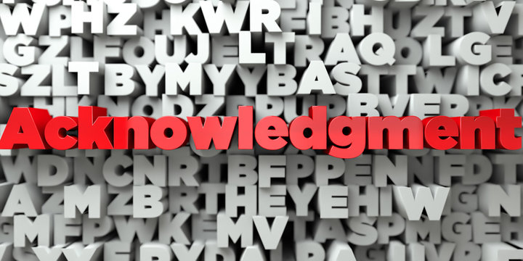
This video series is brought to you by the Team Science Core of the New Jersey Alliance for Clinical and Translational Science (NJ ACTS) (co-leaders Richard Dool, Daniel B. Horton, Nancy E. Reichman) with funding from the National Center for Advancing Translational Sciences of the National Institutes of Health under award number UM1TR004789.

Slide 20
References
Comella-Dorda, S., Sohoni, V., Sunderraj, A., Gardner, D., & McCoy, L. (2024, December 10). What makes product teams effective? McKinsey & Company. https://www.mckinsey.com/capabilities/tech-and-ai/our-insights/what-makes-product-teams-effective
Gartner. (2024). 2024 Gartner employee collaboration research. https://www.gartner.com/en/documents/5351963
Blanchard, E. (2020, July 1). It's time to develop teams. TD Magazine, Association for Talent Development. https://www.td.org/content/td-magazine/its-time-to-develop-teams

Slide 21
References
Brandon Hall Group. (2024). Identifying the Key Differences Between Leadership and Management Skills. https://institute.brandonhall.com/wp-content/uploads/2024/06/BHG_Identifying-the-Key-Differences-Between-Leadership-and-Management-Skills_SB-1.pdf
Deloitte Global Human Capital Trends (2024). https://www.deloitte.com/za/en/services/consulting/research/2024-human-capital-trends.html
ADP Research Institute. (2025). People at Work 2025: A Global Workforce View. https://sg.adp.com/resources/insights/people-at-work-2025-a-global-workforce-view.aspx
Center for Creative Leadership (2025). Documenting Which Leadership Competencies are Most Needed. https://www.ccl.org/articles/leading-effectively-articles/most-important-leadership-competencies/

